Slide 1
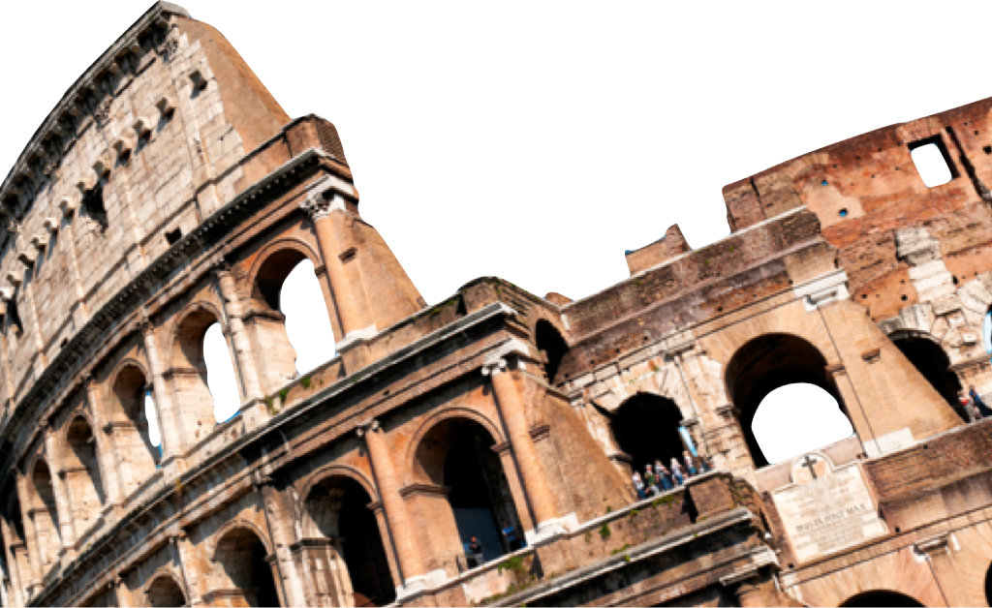
ROMANS
Romans 1-3:20
Overview
Laying a solid foundation
Paul Bucknell

Slide 2


Purpose of Romans
Proclaim and defend God’s great plan to establish His righteousness
through the Gospel of Jesus Christ in all His peoples, Jew and Greek.
With God
• Jewish Tract
• Clarify Gospel
• Help Church
With Man
1:8-15
15:20-32
• Jewish Tract
• Clarify Gospel
• Help Church
1:8-15
15:20-32

Slide 3


Overview of Romans
God’s Purpose of Romans for us
God’s goals for Romans
What does He want to teach me or change in my life through the Book of Romans?
Laying a solid foundation for the people of God
The gospel of Jesus Christ is presented, defended and applied so that God’s people, no matter what nationality, completely set themselves apart for God (Rom 12:1-2).
“I urge you therefore, brethren, by the mercies of God, to present your bodies a living and holy sacrifice, acceptable to God, which is your spiritual service of worship. And do not be conformed to this world, but be transformed by the renewing of your mind, that you may prove what the will of God is, that which is good and acceptable and perfect” (Rom 12:1-2).
Romans: Chapters 1-11

Slide 4
Overview of Romans
Two Powerful Quotes
“I felt my heart strangely warmed. I felt I did trust in Christ, Christ alone, for salvation; and an assurance was given me that He had taken away my sins, even mine, and saved me from the law of sin and death.” – John Wesley 1738
“For I am not ashamed of the gospel, for it is the power of God for salvation to everyone who believes, to the Jew first and also to the Greek. For in it the righteousness of God is revealed from faith to faith; as it is written, ‘BUT THE RIGHTEOUS man SHALL LIVE BY FAITH’” (Romans 1:16-17).

Slide 5
Overview of Romans
The Situation of the Book of Romans
The city of Rome
The believers in Rome
Persecution against Jewish people and Christians
The time of its writing (15:26; 16:1)
The occassion for its writing
Clarify the gospel due to the absence of an apostle’s presence
Provides that key Jewish-Gentile Christian perspective for peace
A Jewish gospel tract - save his Jewish brethren
Announce his plans for a trip to Rome and far West (1:8-15 and 15:20-32).

Slide 6
Overview of Romans
Laying a solid Foundation
A. Righteousness Revealed: Gospel (Rom 1:1-17)
B. Righteousness Obsolete: Sin (Rom 1:18-3:20)
C. Righteousness Made: Justification (Rom 3:21-5:21)
D. Righteousness Attained: Sanctification (Rom 6-8)
E. Righteousness eNlarged: Worldwide (Rom 9-11)
F. Righteousness Spread: Service (Rom 12-16)
RIGHTEOUSNESS

Slide 7
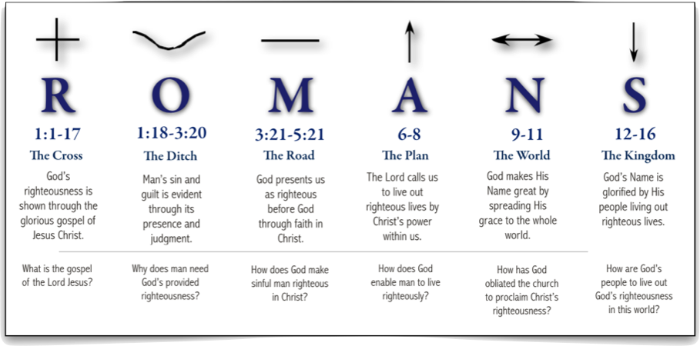
Overview of Romans
A graphical Outline of Romans

Slide 8

The Gospel’s Message ( Rom 1:1-7)
R
The powerful gospel message and its implications for our lives is presented in Romans 1:1-7.
Romans 1:1-7 answers the question, “What is the Gospel?”
God’s righteousness is shown through the glorious Gospel of Jesus Christ. (1:1,9,15,16)
R
1:1-17
The Cross
RIGHTEOUSNESS
REVEALED

Slide 9
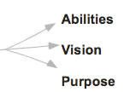
The Gospel’s Message ( Rom 1:1-7)
1. The Proclaimer of the Gospel (1:1)
¹Paul, a bond-servant of Christ Jesus, called as an apostle, set apart for the gospel of God.
Paul the slave of Christ Jesus
Called as an apostle
Purposed: “Set apart for the gospel of God.”

Slide 10
God’s Plan Revealed ( Rom 1:2-6)
² Which he promised beforehand through his prophets in the Holy Scriptures. ³Concerning his son, who was born of the seed of David according to the flesh, ⁴who was declared with power to be the Son of God by the resurrection from the dead according to the Spirit of holiness, Jesus Christ our Lord, ⁵through whom we have received grace and apostleship to bring about the obedience of faith among all the Gentiles, for His name’s sake. ⁶Among whom you also are the called of Jesus Christ;
Gospel is all about Jesus (3)
Jesus’ earthly birth (3)
Jesus’ death (4)
Jesus’ resurrection (4)
Jesus’ lordship (4)
Jesus’ grace and gifts (5)
Jesus’ mission (5)
Note Romans 12 where Paul clearly sees each believer a member of Christ’s body and each having a spiritual gift and responsibility for the body of Christ and the lost.

Slide 11
Righteousness revealed (1:16-17)
⁶ For I am not ashamed of the gospel, for it is the power of God for salvation to everyone who believes, to the Jew first and also to the Greek. For in it the righteousness of God is revealed from faith to faith; as it is written, “BUT THE RIGHTEOUS man SHALL LIVE BY FAITH.” (Romans 1:16-17).
“Not ashamed of the gospel”
“Power of God”
“To everyone who believes”
“Of God revealed”
“Righteous man shall live by faith”
R
1:1-17
The Cross
RIGHTEOUSNESS
REVEALED

Slide 12
Righteousness Obsolete (1:18-3:20)
Man’s sin and guilt is evident through sin’s presence and judgment.
Why does man need God’s provided righteousness?
O
1:18-3:20
The Ditch
RIGHTEOUSNESS
OBSOLETE

Slide 13


Righteousness Obsolete (1:18-3:20)
Man’s evident guilt/curse
“For the wrath of God is revealed from heaven against all ungodliness and unrighteousness of men, who suppress the truth in unrighteousness” (Romans 1:18).
SUPPRESSED
O
O
1:18-3:20
REVEALED
The Ditch

Slide 14
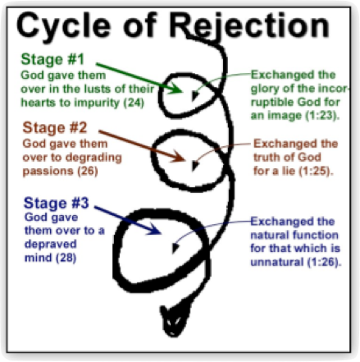

Righteousness Obsolete (1:19-32)
Rejection of Light (Exchanged)
“For since the creation of the world His invisible attributes, His eternal power and divine nature, have been clearly seen, being understood through what has been made, so that they are without excuse.” (Romans 1:20).

Slide 15
Righteousness Obsolete (2:1-14)
Self-righteous guilt
“Therefore you are without excuse, every man of you who passes judgment, for in that you judge another, you condemn yourself; for you who judge practice the same things.” Romans 2:1, NASB.
O
1:18-3:20
The Ditch
“No partiality with God” (2:11)
With law
Without law

Slide 16
Righteousness Obsolete (2:15-29)
Conscience - self imposed guilt
“In that they show the work of the Law written in their hearts, their conscience bearing witness, and their thoughts alternately accusing or else defending them,” (Romans 2:15).
O
1:18-3:20
With law
The Ditch
Without law
Everyone
“Who will render to every man according to his deeds” (Ro 2:6; Ps 62:11-12).

Slide 17
Righteousness Obsolete (3:9-20)
O
Total depravity (3:9-20)
None righteous (2:10)
None who understands (2:11)
None who seeks for God (2:11)
None who does God (2:12)
No fear of God before their eyes (18)
O
1:18-3:20
The Ditch
RIGHTEOUSNESS
OBSOLETE

Slide 18
Righteousness Obsolete (3:20)
Implications of Sin
“That every mouth may be closed, and all the world may become accountable to God” (Ro 3:20).
O
* Gentiles - obvious sin
1:18-3:20
+
* Jews - obvious guilt (under the law)
The Ditch
All the world
Everyone needs righteousness-no exceptions!

Slide 19
ROMANS
Romans 1-3:20
Overview
Laying a solid foundation
Paul Bucknell

