Slide 1
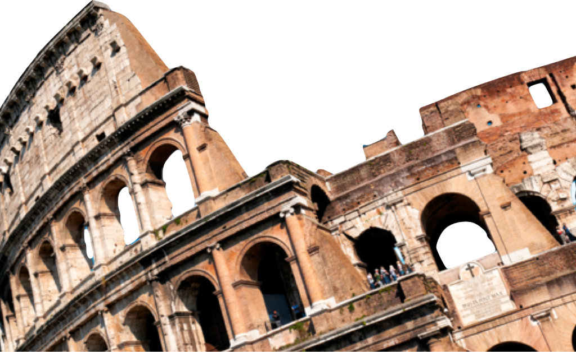
ROMANS
Romans 9 -16
Overview
Laying a solid foundation
Paul Bucknell

Slide 2
Outline of Romans
Laying a solid Foundation
A. Righteousness Revealed: Gospel (Rom 1:1-17)
B. Righteousness Obsolete: Sin (Rom 1:18-3:20)
C. Righteousness Made: Justification (Rom 3:21-5:21)
D. Righteousness Attained: Sanctification (Rom 6-8)
E. Righteousness eNlarged: Worldwide (Rom 9-11)
F. Righteousness Spread: Service (Rom 12-16)
RIGHTEOUSNESS

Slide 3

Overview
1-5
Abram’s
faith
12-16
How does one become righteous?
2nd Adam
How does one live a righteous life?
Olive tree

Slide 4
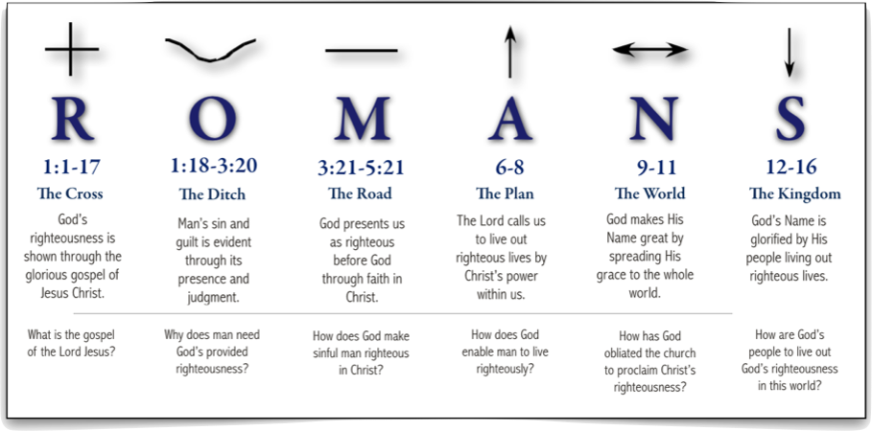
Overview of Romans
Proclaim and defend God’s great plan to establish His righteousness through the Gospel of Jesus Christ in all His peoples, Jew and Greek.

Slide 5
Book of Romans Ch. 9-11
N
God makes His Name great by spreading His grace to the whole world.
How has God made the proclamation of Christ’s righteousness mandatory?
N
9 - 11
The WORLD
RIGHTEOUSNESS
ENLARGED

Slide 6
Book of Romans 9:1-13
Paul’s compassion for Israel (9:1-5)
God is faithful. God’s Word did not fail. (9:6-13)
N
9 - 11
“But it is not as though the word of God has failed. For they are not all Israel who are descended from Israel” (9:6).
The WORLD

Slide 7
Book of Romans 9:14-23
Is God fair? -question of election
“So then He has mercy on whom He desires, and He hardens whom He desires” (9:18-20).
N
9 - 11
The WORLD
And He did so in order that He might make known the riches of His glory upon vessels of mercy, which He prepared beforehand for glory” (9:23).

Slide 8
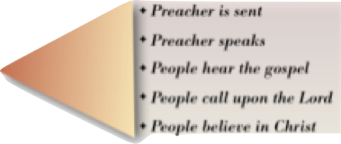
Book of Romans 9:24-10
Inclusion of Gentiles in His Plan (24-26)
God chooses whoever He wills (9:27-32)
OT confirmation of His will (10:1-21)
“For the Scripture says, “WHOEVER BELIEVES IN HIM WILL NOT BE DISAPPOINTED.” For there is no distinction between Jew and Greek; for the same Lord is Lord of all...” (10:11-12).
(10:13-17)

Slide 9
Book of Romans Ch. 11
What about promises to Jews?
#1 Not rejected chosen Israelites (1-10)
#2 Greater blessings on believing Jews (11-15)
#3 Gentiles grafted on Israel olive tree (16-25)
#4 All Israel thus be saved (26-32)
#5 God’s great mystery fulfilled! (33-36)
“Oh, the depth of the riches both of the wisdom and knowledge of God! How unsearchable are His judgments and unfathomable His ways!” (Romans 11:33).

Slide 10
Book of Romans Ch. 12-16
S
God’s Name is glorified by His people living out righteousness lives.
How are God’s people to live out God’s righteousness in this world?
S
12-16
The Kingdom
RIGHTEOUSNESS
SPREAD

Slide 11
Book of Romans – Vision
The vision:
Nothing need to stop us from living a righteous life (8:15). This righteousness created by the Spirit of God brings glory to God as we live out His righteousness in our lives. This is His righteous kingdom.
S
12-16
The Kingdom
RIGHTEOUSNESS
SPREAD

Slide 12
Book of Romans 12:1-2
Our dedication to God
“I urge you therefore, brethren, by the mercies of God, to present your bodies a living and holy sacrifice, acceptable to God, which is your spiritual service of worship. And do not be conformed to this world, but be transformed by the renewing of your mind, that you may prove what the will of God is, that which is good and acceptable and perfect.” (Romans 12:1-2).
S
12-16
The Kingdom

Slide 13
Book of Romans 12:3-8
Love in God’s Body (12-16)
Spiritual Gifts (12:3-8)
“For just as we have many members in one body and all the members do not have the same function, so we, who are many, are one body in Christ, and individually members one of another. And since we have gifts that differ according to the grace given to us, let each exercise them accordingly: if prophecy, according to the proportion of his faith” (Romans 12:4-6).
S
12-16
The Kingdom

Slide 14
Book of Romans 12:9-21
Obligations to others (12:9-21)
“Let love be without hypocrisy. Abhor what is evil; cling to what is good. Be devoted to one another in brotherly love; give preference to one another in honor; not lagging behind in diligence, fervent in spirit, serving the Lord” (Romans 12:9-11).
S
12-16
The Kingdom
“For he who loves his neighbor has fulfilled the law” (13:8).

Slide 15
Book of Romans 13
Living in the world (13)
“Let every person be in subjection to the governing authorities. For there is no authority except from God, and those which exist are established by God.” (Romans 13:1).
S
Our neighbors (13:8-14)
12-16
“Love does no wrong to a neighbor; love therefore is the fulfillment of the law.” (Romans 13:10).
The Kingdom
Not in carousing and drunkenness, not in sexual promiscuity and sensuality” (Romans 13:13).

Slide 16
Book of Romans 14
Living with Others (14)
“Let not him who eats regard with contempt him who does not eat, and let not him who does not eat judge him who eats, for God has accepted him.” (Romans 14:3).
“For if because of food your brother is hurt, you are no longer walking according to love. Do not destroy with your food him for whom Christ died.” Romans 14:15.
S
12-16
The Kingdom

Slide 17
Book of Romans 14
Going Beyond (15-16)
“Wherefore, accept one another, just as Christ also accepted us to the glory of God. ... and for the Gentiles to glorify God for His mercy; as it is written, “THEREFORE I WILL GIVE PRAISE TO THEE AMONG THE GENTILES, AND I WILL SING TO THY NAME.”” (Romans 15:7-9).
S
12-16
The Kingdom
3 benedictions
15:13, 33
16:25-27

Slide 18



Overview of Romans
Proclaim and defend God’s great plan to establish His righteousness through the Gospel of Jesus Christ in all His peoples, Jew and Greek.
00

Slide 19
ROMANS
Romans 9 -16
Overview
Laying a solid foundation
Paul Bucknell

