Slide 1
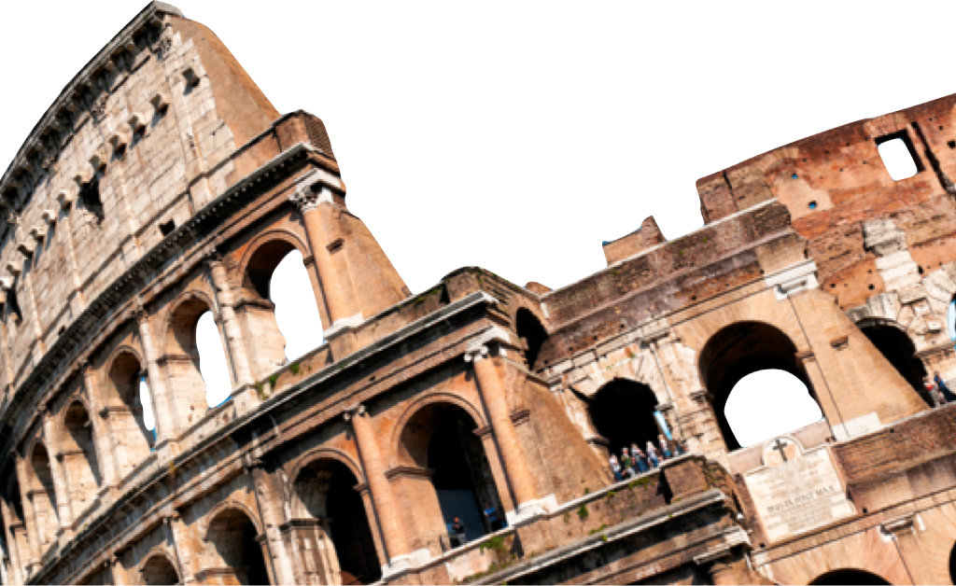
ROMANS
Romans 3:21-8
Overview
Laying a solid foundation
Paul Bucknell

Slide 2
Overview of Romans
Laying a solid Foundation
A. Righteousness Revealed: Gospel (Rom 1:1-17)
B. Righteousness Obsolete: Sin (Rom 1:18-3:20)
C. Righteousness Made: Justification (Rom 3:21-5:21)
D. Righteousness Attained: Sanctification (Rom 6-8)
E. Righteousness eNlarged: Worldwide (Rom 9-11)
F. Righteousness Spread: Service (Rom 12-16)
RIGHTEOUSNESS

Slide 3
Book of Romans 3:21-5:21
M
God presents us as righteous before God through faith in Christ.
How does God make sinful men and women righteous?
M
3:21-5:21
The ROAD
RIGHTEOUSNESS
MADE

Slide 4
Book of Romans 3:21-5:21
Religious
Religion gets its power from man’s drive to fill his soul’s guilt and emptiness. Pride keeps the religious man from sincere examination.
“Now apart from the Law the righteousness of God has been manifested... even the righteousness of God through faith in Jesus Christ...” (3:21-22).
M
3:21-5:21
The ROAD

Slide 5
Book of Romans 3:21-22
Religious
Religion gets its power from man’s drive to fill his soul’s guilt and emptiness. Pride keeps the religious man from sincere examination.
“Now apart from the Law the righteousness of God has been manifested... even the righteousness of God through faith in Jesus Christ...” (3:21-22).
M
3:21-5:21
The ROAD

Slide 6
Book of Romans 3:24-25
Atonement - sacrifice
“Being justified as a gift by His grace through the redemption which is in Christ Jesus; whom God displayed publicly as a propitiation in His blood through faith. This was to demonstrate His righteousness, because in the forbearance of God He passed over the sins previously committed” (Romans 3:24-25).
M
3:21-5:21
The ROAD
RIGHTEOUSNESS
MADE

Slide 7
Book of Romans 4
Illustrations from the OT (4)
Abraham (4:1-5)
David (4:6-8)
Timing of circumcision (4:9-12)
Gen 15:5-6 => Gen 17:9-14
Faith => promises (4:13-25)
M
3:21-5:21
The ROAD
RIGHTEOUSNESS
MADE

Slide 8
Book of Romans 5
Blessings from the Promise (5)
“Having been justified by faith, we have ..... (5:1-11; 4:13,16)
Jesus, 2nd Adam (5:12-21)
“Grace abounded all the more, ...so grace might reign through righteousness to eternal life through Jesus Christ our Lord.” (Romans 5:20-21).
M
3:21-5:21
The ROAD
RIGHTEOUSNESS
MADE

Slide 9


R
O
M
RIGHTEOUSNESS
Revealed
Blessing
Obsolete
Made

Slide 10
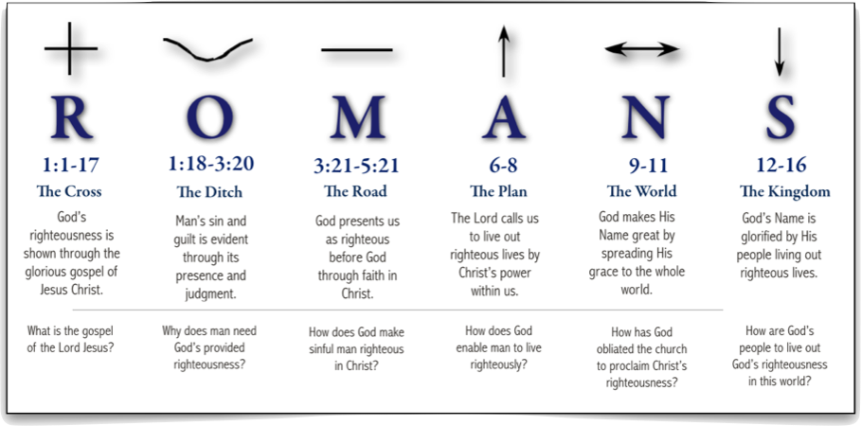
Overview of Romans
Proclaim and defend God’s great plan to establish His righteousness through the Gospel of Jesus Christ in all His peoples, Jew and Greek.

Slide 11

Overview
?
1-5
12-16
6-11

Slide 12
Book of Romans - A Pattern
The Pattern
Introductory question (e.g. 6:1)
“May it never be!”
Refutation
Argumentation
A
6-8
The PLAN
6:1-2, 6:15, 7:7, 7:13
9:14, 11:1, 11:11

Slide 13
Misunderstandings
Eliminating 4 Misunderstandings
“I can do whatever I want now. God even brings more grace through my sin.” (6:1-14 => baptism)
“This is an age of grace, is it not? (6:15-7:6 => new master)
“That’s good to hear. Sin isn’t my fault. The law is sin.” (7:7-7:12)
Without the Law, I would have been okay. It is really God’s fault; He shouldn’t have given us the Law.” (7:13-25 = my flesh)
A
6-8
The PLAN

Slide 14
Book of Romans - 8:1-17
Romans 8:1-17
It is possible that chapter 8 is continuation of 7:13-25 argumentation.
Or affirmation of blessing of Holy Spirit’s control and dwelling from Abraham.
A
6-8
Flesh <=> Spirit
The PLAN
“However, you are not in the flesh but in the Spirit, if indeed the Spirit of God dwells in you. But if anyone does not have the Spirit of Christ, he does not belong to Him.” (Romans 8:9).

Slide 15

Book of Romans 8:18-39
Problem of suffering (8:18-39)
Spirit (promise) & Suffering? (18-25)
Spirit’s involvement (26-30)
A
6-8
The PLAN
RoMANS 8:29-30
God is amazingly committed to us (31-39)
Personal ~ Powerful ~ Prepared ~ Purposeful

Slide 16
RIGHTEOUSNESS
R
O
M
A
Revealed
N
Obsolete
Made
Attained
Blessing
eNlarged

Slide 17
ROMANS
Romans 3:21-8
Overview
Laying a solid foundation
Paul Bucknell

